Slide 1





ACC WORKSHOP
Optimizing BIM Collaboration: ACC Workflow from Design to Construction
E-Learning
AMC Workshop instructor
Eng. Mohamed Magdy
Autodesk Construction Cloud (ACC) Workflow – From Model Coordination to Project Delivery
This workshop explores the practical workflow of Autodesk Construction Cloud (ACC) in managing BIM projects from design coordination to construction delivery. We will cover document management, model coordination, issue tracking, approval cycles, and real-time collaboration strategies to enhance project efficiency and reduce risks.
www.amcengineer.com

Slide 2
Today's Agenda
What is ACC ?
ACC Features
ACC Packages
ACC & BIM Relationship
Practical Stage (Live Demo Section)
Questions
Q & A

Slide 3


Level Up Your
Collaboration
What is ACC ?
Autodesk Construction Cloud (ACC) is a cloud-based project management and collaboration platform that connects design, engineering, and construction teams in one centralized digital environment.
Powered by/

Slide 4
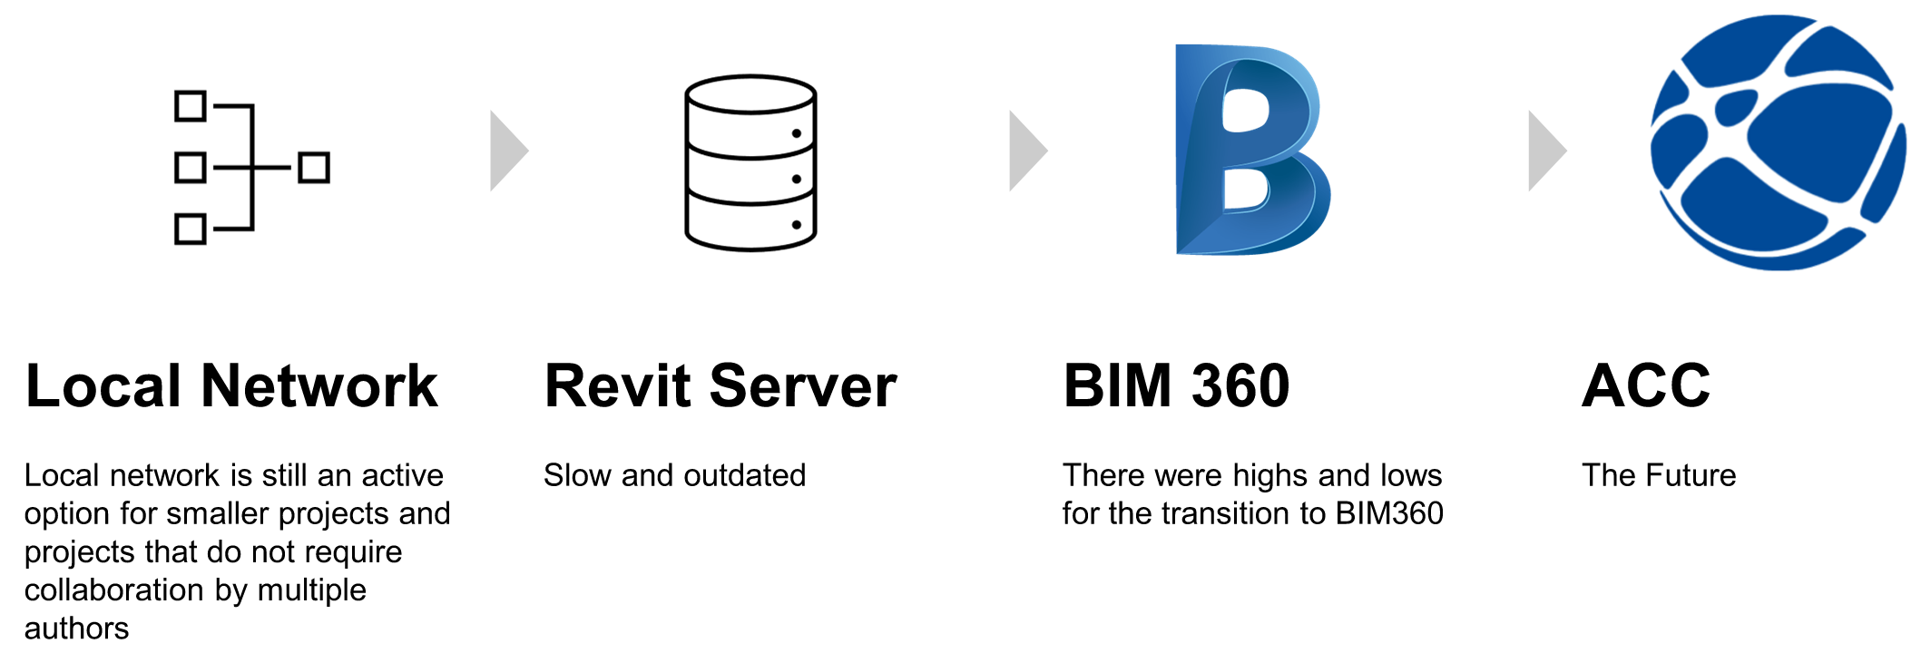
What is ACC ?
Clear Work sample for the workshop name
From Local Network to the Cloud

Slide 5
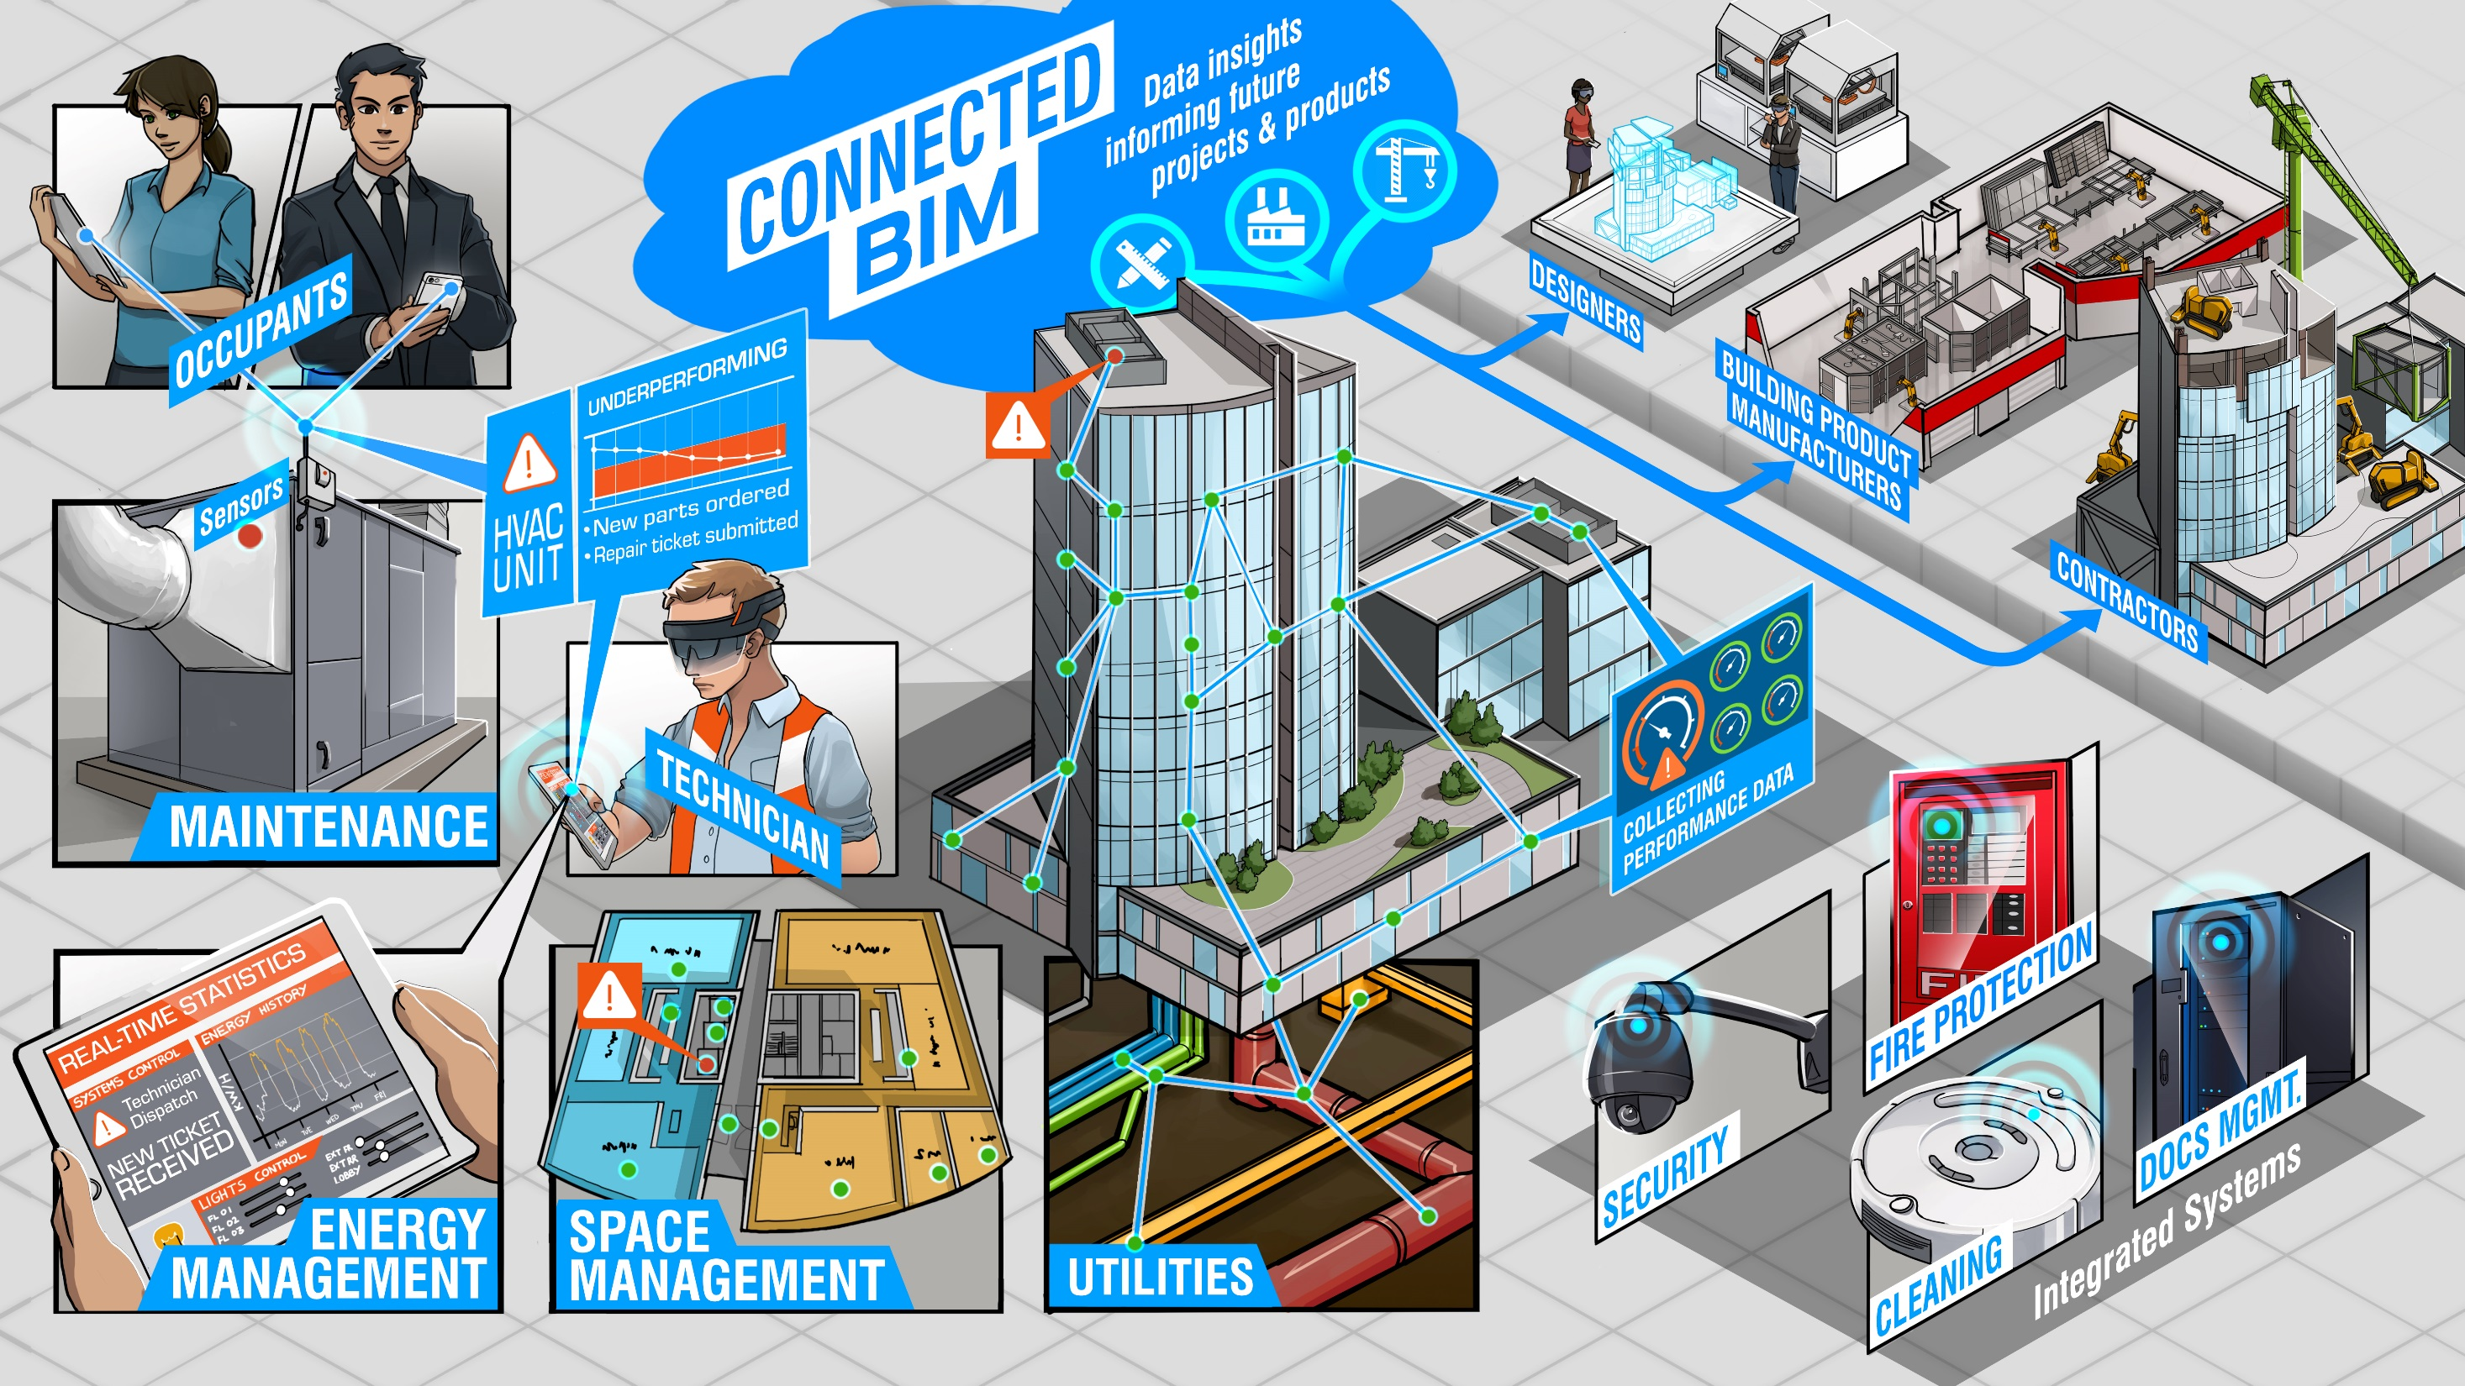
What is ACC ?
Clear Work sample for the workshop name
ACC Enables to:
Centralized document management
Real-time Model collaboration
Issue tracking and coordination
Controlled approval workflows
Data-driven project monitoring
ACC acts as a Common Data Environment (CDE) for the entire project lifecycle.

Slide 6
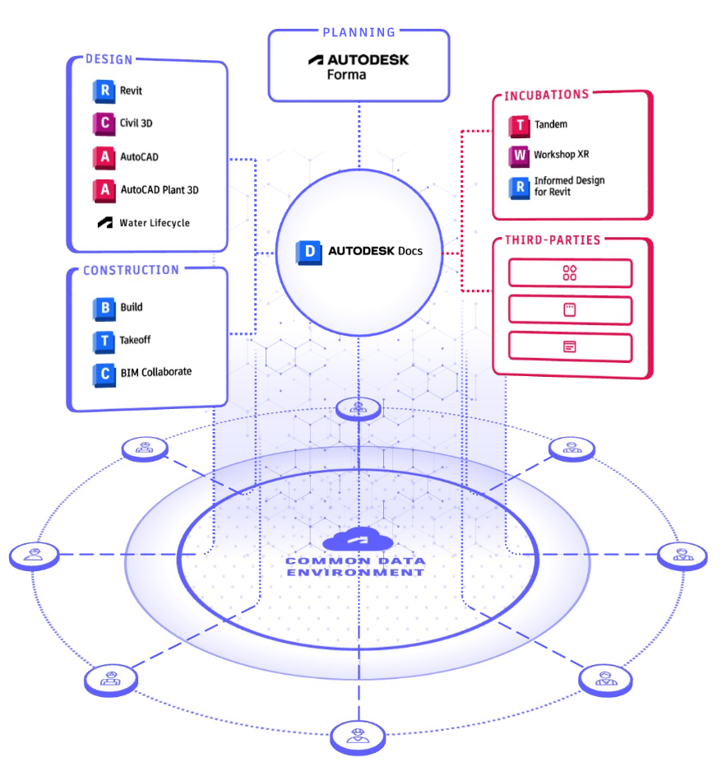
ACC Features
Clear Work sample for the workshop name
Cloud Document Management (Autodesk Docs)
Version Control & File Comparison
Model Coordination & Clash Detection
Issue Tracking System
Role-Based Permissions
Approval Workflows
4D Integration Support
Real-Time Dashboards & Reporting

Slide 7
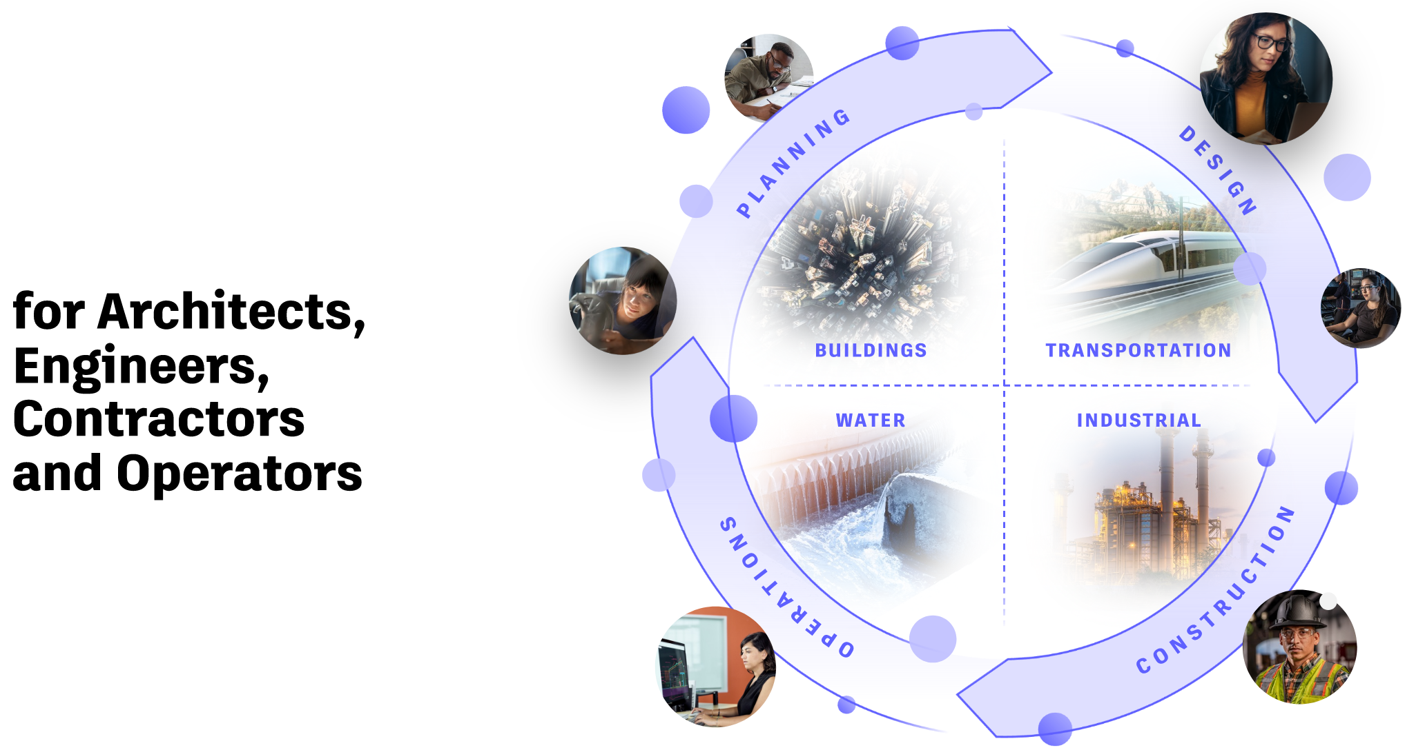
ACC Features

Slide 8
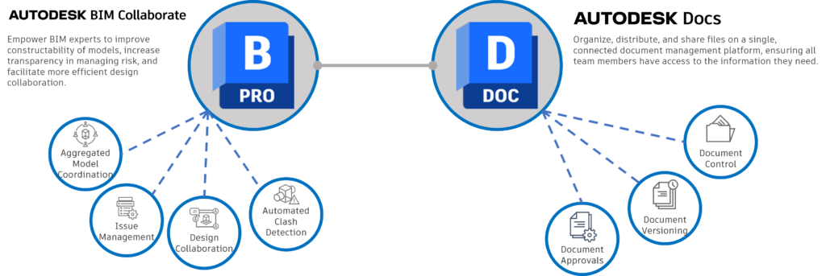
ACC Ecosystem Overview
Autodesk Docs
ACC Packages
Autodesk Docs
BIM Collaborate
Build
Takeoff

Slide 9
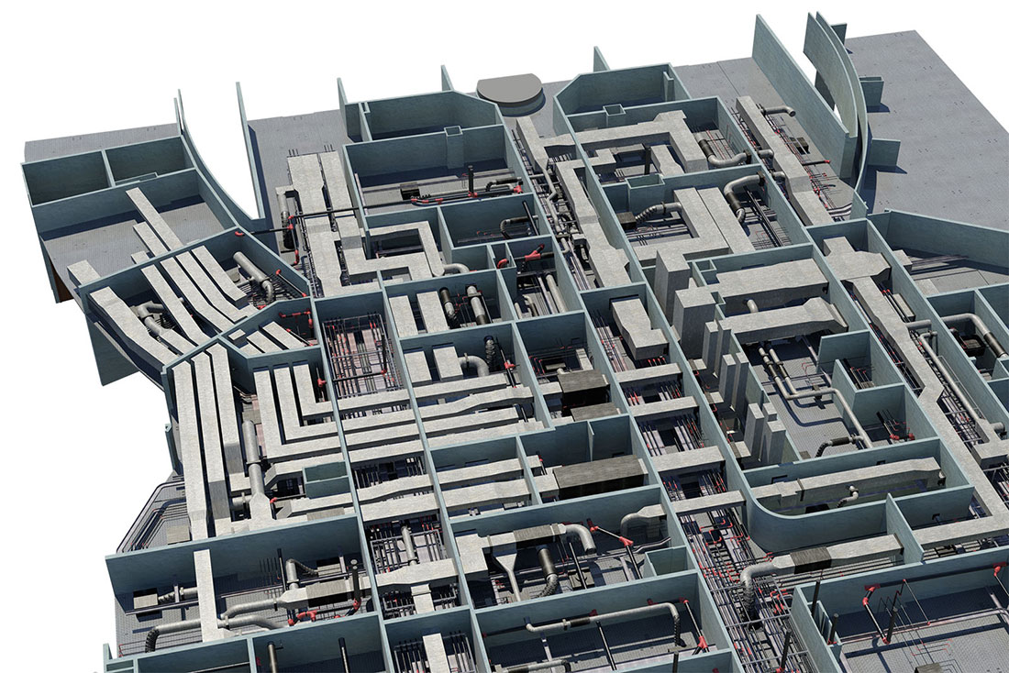
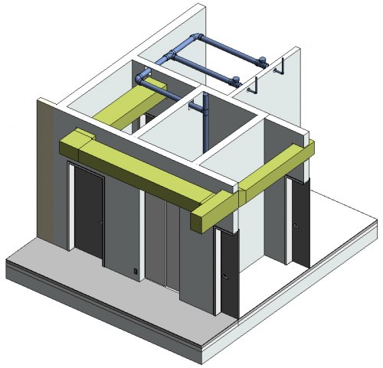
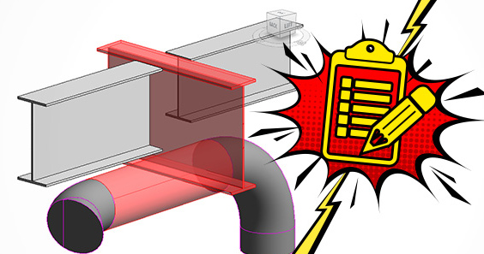
Autodesk Docs
ACC & BIM Relationship
Hosting federated BIM models in the cloud
Enabling real-time multi-discipline collaboration
Managing clashes digitally
Linking issues directly to model elements
Maintaining model version history
Supporting BIM from LOD 100 to LOD 500

Slide 10
Practical Stage (Live Demo Section)

Slide 11
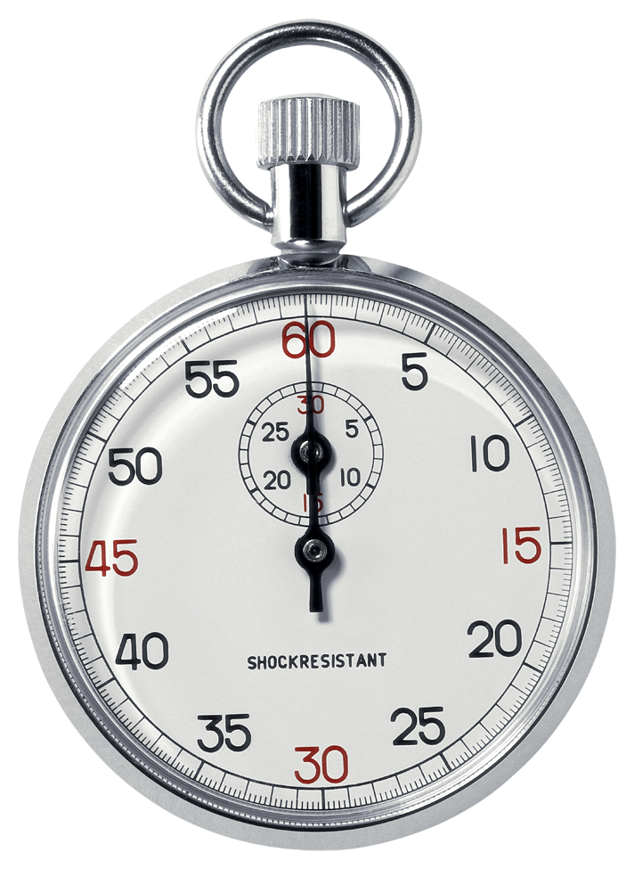
Let’s Evaluate our Current Workflow

Slide 12
Questions
1- What is your biggest coordination challenge?
A) File version confusion
B) Delayed approvals
C) Clash tracking issues
D) Poor communication between teams

Slide 13
Questions
2- How do you currently manage drawing revisions?
A) Email attachments
B) Shared local server
C) WhatsApp / informal sharing
D) Cloud platform (ACC or similar)

Slide 14
Questions
3- How do you track clashes in your project?
A) Excel sheet
B) Manual meeting notes
C) Navisworks only (offline reports)
D) Cloud-based issue tracking

Slide 15
Questions
4- How long does your approval cycle usually take?
A) Less than 3 days
B) 3–7 days
C) 1–2 weeks
D) More than 2 weeks

Slide 16
Questions
5- If you could improve one process in your project, what would it be?
A) Faster approvals
B) Better coordination
C) Clear responsibility tracking
D) Real-time reporting

Slide 17
Q&A

Slide 18

Thank you.
www.amcengineer.com

